Slide 1

Application: MaidEase Type: Application Architecture View: Logical View Style: Layered Architecture Pattern
Users
Delivery Channels
Core Business Processes
Data And Information
Technology Enablers
Account Management
User Information
For Database
Provide services
Location
Connection for Database (MySql)
Subscribed Users
Mobile App
Provide membership
Service Provider Information
Add Service
Service Information
Location API (Google API)
Subscribed service providers
Message
Contacts
User Interface (React, ExpressJS,NextJS,NodeJS)
Browser
Feedback
Feedback
Application Hosting Server (AWS Elastic)
Locate User
Payment
Github & Delivery Pipeline
Manager
Locate Service Provider
Address

Slide 2
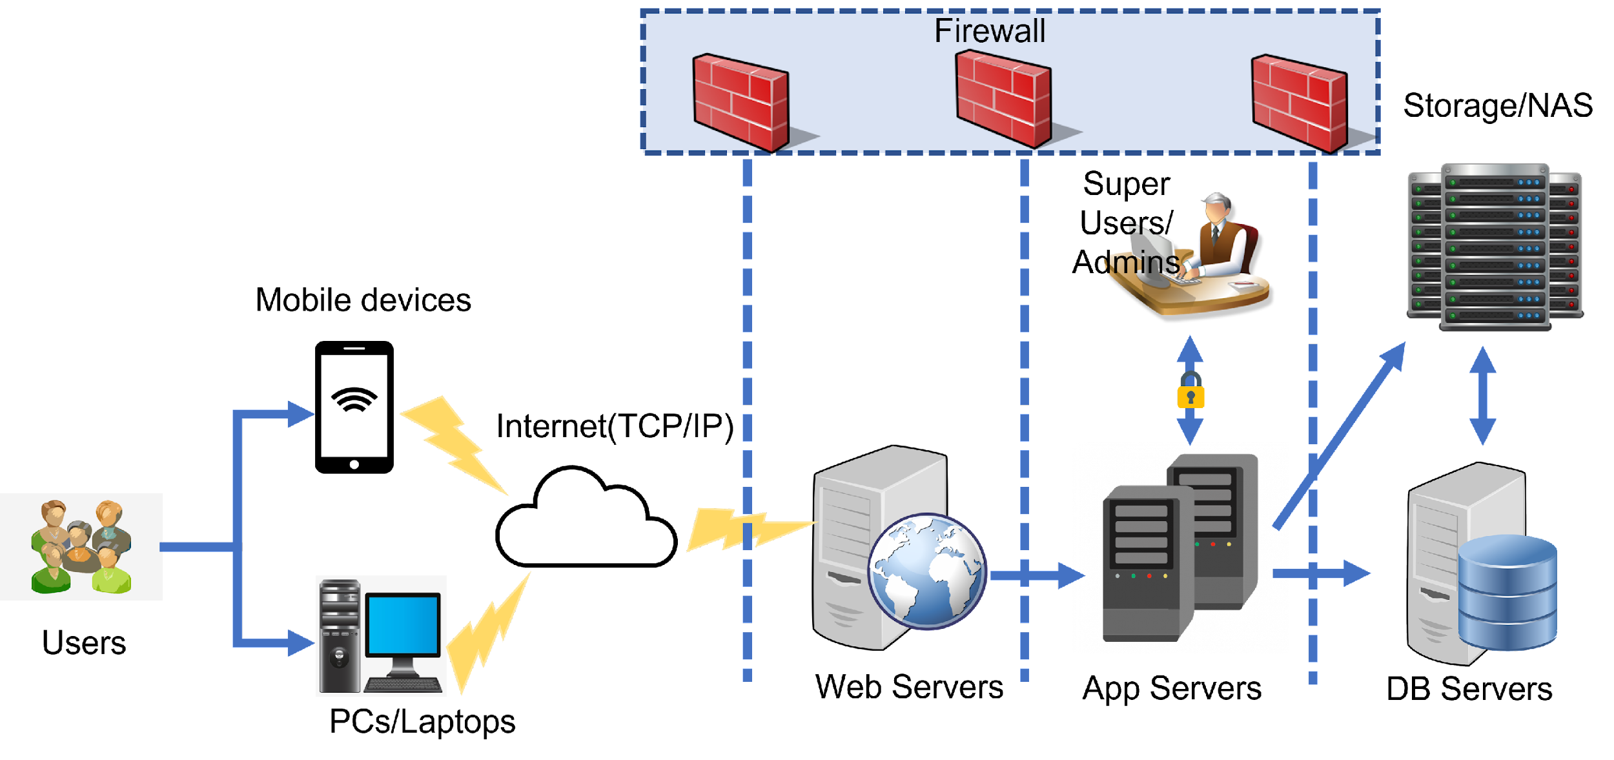
Application: MaidEase Type: Application Architecture View: Process View Style: Client-Server Pattern

Slide 3
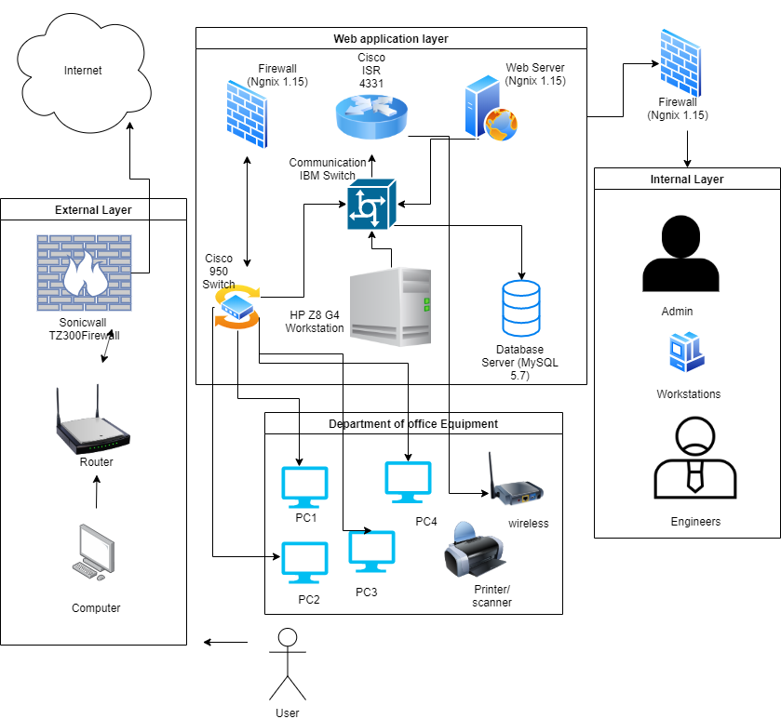
Application: MaidEase Type: Application Architecture View: Logical View Style: Layered Architecture Pattern
user

